Slide 1
Second Hand Car Dataset
Data Analytics Project
Cars
Presented By Antasha D. Lamb Click for Google Document
2/24/2025

Slide 2
Introduction
Data Analytics Project
Data collection and Credibility
This dataset was collected from Kaggle Second Hand Car Analysis by ISHAAN. This Notebook has been released under the Apache 2.0 open source license.
SUBHEAD
The business problem and or question that we are trying to answer is. What does the auto market look like and is it a buyers market or a sellers market? How affordable is a new car and what is the average price that the buyer should go by? And lastly what factors determine the total cost of a vehicle?
The key decision-making points of the analysis is selling price, engine size, mileage driven, torque, and lastly the name of the car.
The expected outcome of this analysis is to attain total understanding of this dataset. Obtain usable and insightful data to help consumers make an investment decision that not only benefits the seller but sets the buyer up for a successful purchase.
2/24/2025

Slide 3
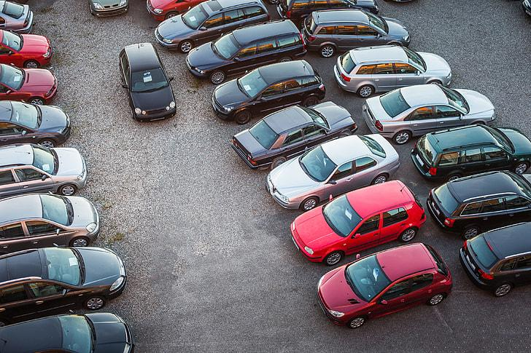
Data Cleaning and Analysis
Data Analytics Project
I have cleaned the data using Python and the Panda library to identify 200 missing values within the mileage, engine,max_power,torque, and seats columns. After cleaning the data by removing duplicates, missing information, and test vehicles within the dataset.I have determined that there are 7905 rows of clean data. The maximum sale was priced at $100,000.00 while the minimum sale price was priced at $29,000.00 and the average sale price was $635,823.60. After identifying this information I concluded my analysis using Google sheets.
Cars
2/24/2025

Slide 4
Columns and snippet of data table
Name_of_Car | year | selling_price | km_driven | fuel | seller_type | transmission | owner | mileage | engine | max_power | torque | seats
Name_of_Car: Ambassador CLASSIC 1500 DSL AC
Ambassador CLASSIC 1500 DSL AC | 2015 | 250000 | 100000 | Diesel | Individual | Manual | Second Owner | 27.62 kmpl | 793 CC | 47 bhp | 125Nm@ 2000rpm | 5
Name_of_Car: Ambassador Classic 2000 DSZ AC PS
Ambassador Classic 2000 DSZ AC PS | 2017 | 750000 | 100000 | Diesel | Individual | Manual | First Owner | 24.52 kmpl | 1248 CC | 88.5 bhp | 200Nm@ 1750rpm | 7
Name_of_Car: Ambassador Grand 1500 DSZ BS III
Ambassador Grand 1500 DSZ BS III | 2008 | 165000 | 90000 | Petrol | Individual | Manual | First Owner | 19.81 kmpl | 1086 CC | 68.05 bhp | 99.04Nm@ 4500rpm | 5

Slide 5
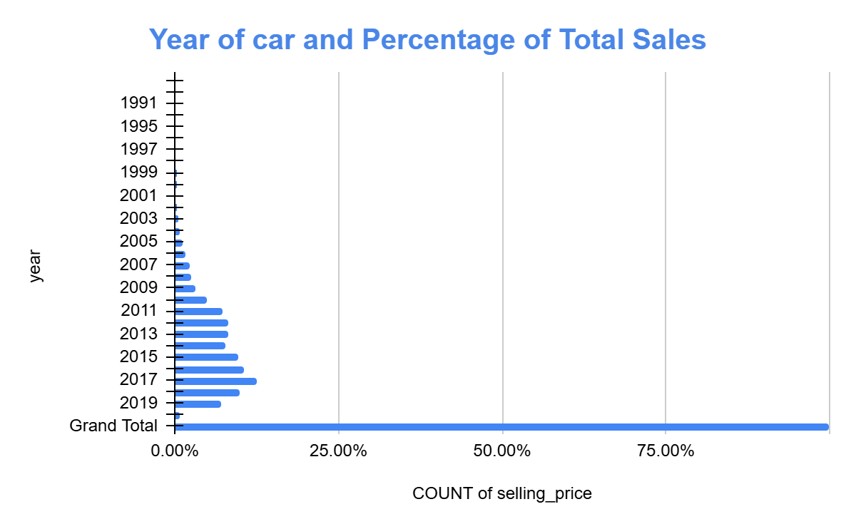
Data Analytics Project
Cars
2/24/2025

Slide 6
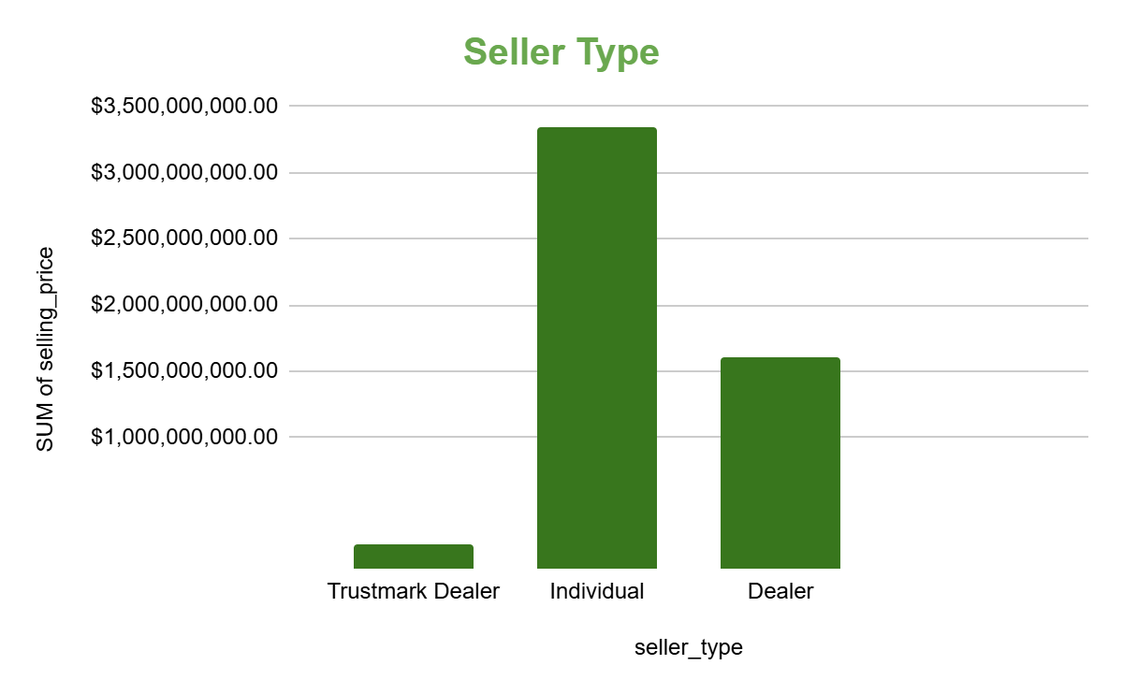
Seller type and Total sales
Data Analytics Project
Cars
Trustmark Dealer
$189,234,000.00
Individual
$3,372,815,296.00
Dealer
$1,603,354,957.00
$0.00
Grand Total
$5,165,404,253.00
2/24/2025

Slide 7
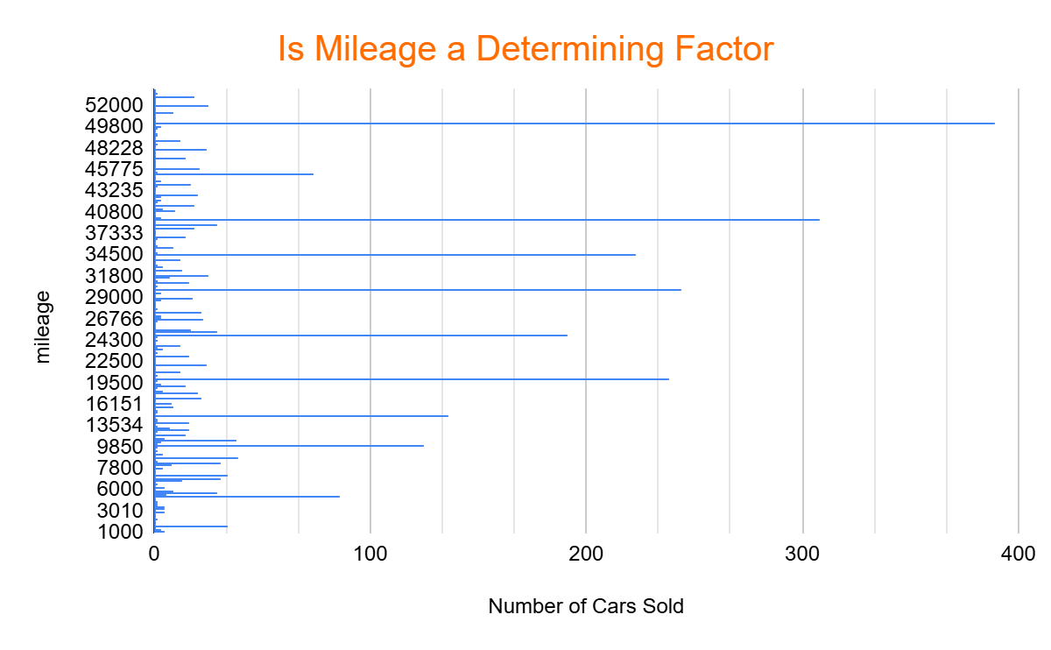
LEADERSHIP WORKSHOP
Cars
2/24/2025

Slide 8
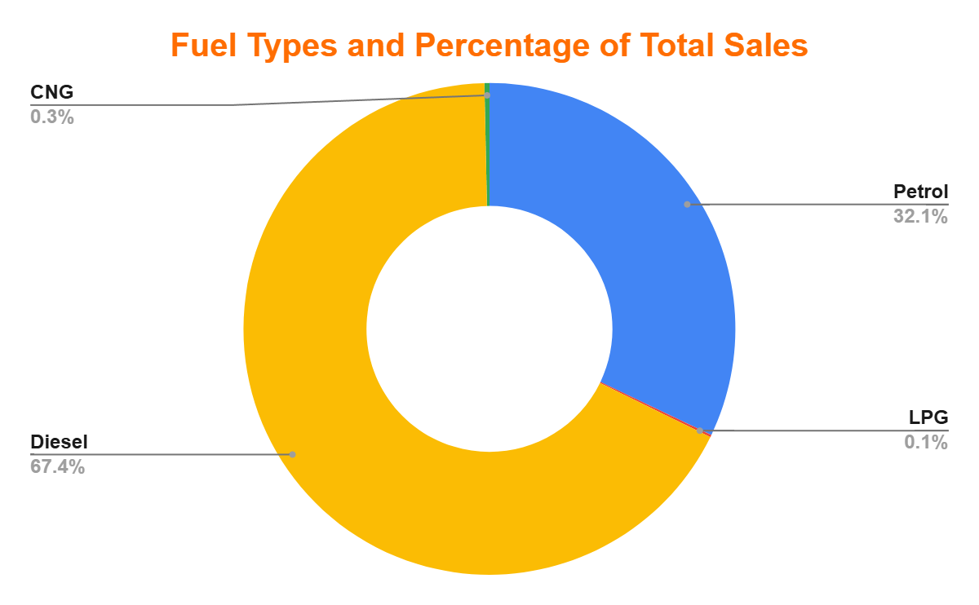
Fuel Type
SUM of selling_price
Petrol
$1,658,454,495.00
LPG
$7,616,000.00
Diesel
$3,482,175,761.00
CNG
$17,157,997.00
$0.00
Grand Total
$5,165,404,253.00
Data Analytics Project
Cars
2/24/2025

Slide 9
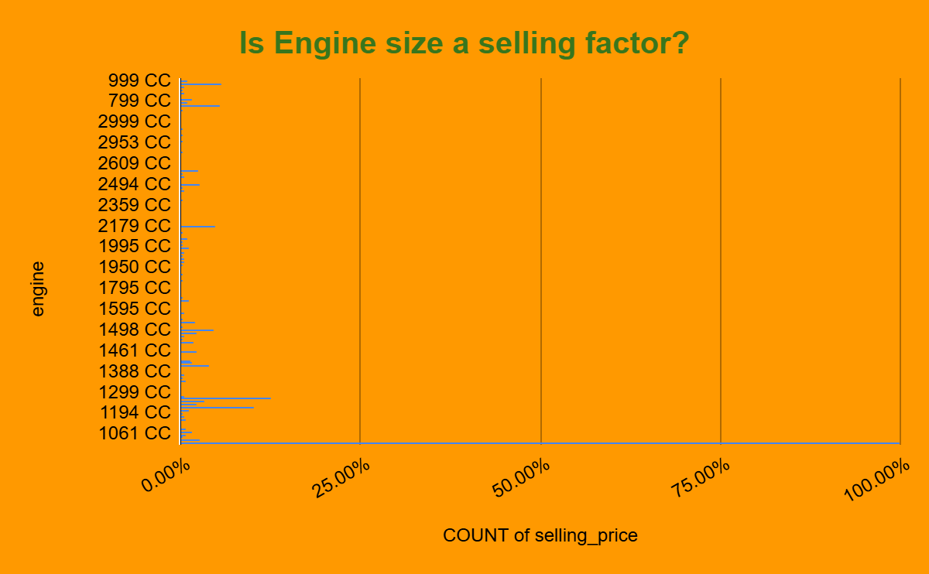
Data Analytics Project
Cars
2/24/2025

Slide 10
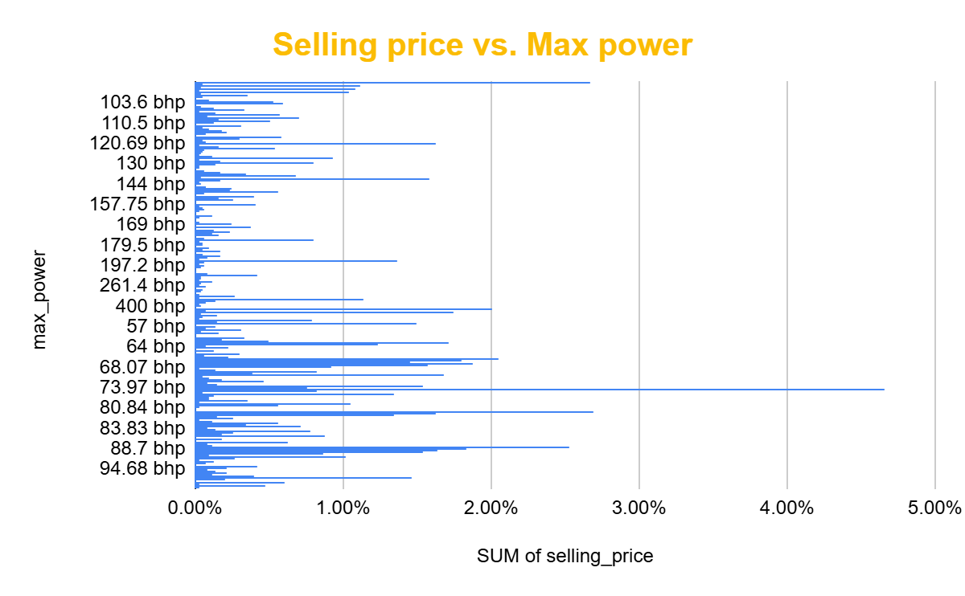
Data Analytics Project
Cars
DATE

Slide 11
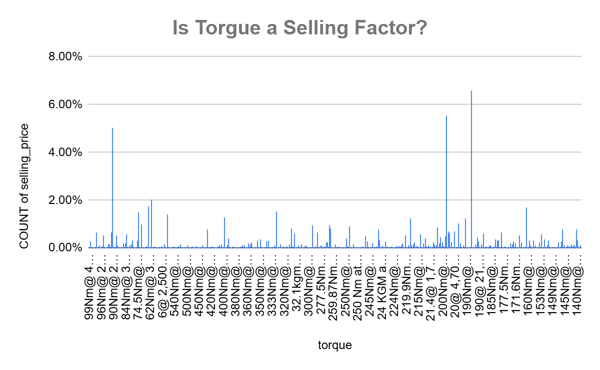
Data Analytics Project
Cars
2/24/2025

Slide 12
Year of the Car; Is this a determining factor? This chart displays the number of cars sold, categorized by their manufacturing year. We see a clear trend of higher sales for more recent models, with 1,009 cars from 2017, 856 from 2016, and 778 from 2015. Notably, there is a single outlier: one car manufactured in 1983 was also sold
Max Power: This chart visualizes the maximum power (bhp) of vehicles in the dataset, revealing a strong presence of vehicles in the 46.3bhp to 88.7bhp range. While this suggests potential desirability, further analysis is needed to confirm this correlation.
Torque:The chart shows the distribution of engine torque amongst sold vehicles, with notable percentages including 6.26% at 190@2000rpm, 5.52% at 200 nm@1750rpm, and 5.05% at 90nm@3500rpm. The relative evenness of the distribution suggests that torque might not be a singular decisive factor in customer purchases, and further analysis involving other factors may be required
Data Analytics Project
Thoughts?
Seller Types: This chart provides a comparative analysis of total sales across three seller categories: Individual, Dealer, and Trustmark Dealer. The data highlights a considerable range in sales volume. Individual sellers accounted for the majority of sales, totaling $3,372,815,269. Dealer sales reached $1,603,354,957, while Trustmark Dealer sales were significantly lower, at $189,234. This indicates that individual sellers are the primary drivers of sales in this market.
Cars
Engine Size: The distribution of car sales, as represented by engine size, is shown in this chart. The 1248 cc engine size constitutes 12.51% of sales, the 1197cc engine size 10.24%, and the 998cc engine size 5.58%
Fuel Types: This chart presents the percentage distribution of car sales across various fuel types. The data reveals a clear preference for Diesel, with 67.4% of sales. Petrol constituted 32.1% of sales. The remaining fuel types, CNG and LPG, represented minimal sales volumes, accounting for 0.3% and 0.1% respectively.
Mileage: This chart illustrates car sales by mileage, revealing a noticeable pattern. Sales are highest for cars with 50,000 miles (389 units), and decrease as mileage declines: 308 cars with 40,000 miles, 244 with 30,000 miles, and 238 with 20,000 miles. This suggests a potential preference for cars with moderate mileage within this dataset.
2/24/2025

Slide 13

What we did
Our analysis reveals that diesel vehicles dominated sales among the eight factors considered, comprising 67.4% of the total. This substantial market share underscores the continued appeal of diesel, particularly for buyers prioritizing fuel efficiency and extended driving range.
Individual sellers represented a clear majority of sales at 65%, while dealers accounted for 31%. This significant difference could indicate a preference for individual sellers, potentially due to the perception of more flexible negotiation.
Preliminary analysis suggests that mileage, engine size, and torque are potentially influential factors in sales trends. However, a more comprehensive investigation is warranted to understand the extent of their impact
Data Analytics Project
Cars
What we learned
"Affordability, longevity, safety, and reliability are key considerations in vehicle purchases. While this dataset reveals various influential factors, the final decision is a personalized one, where buyers weigh these elements against their specific needs and preferences
2/24/2025

Slide 14
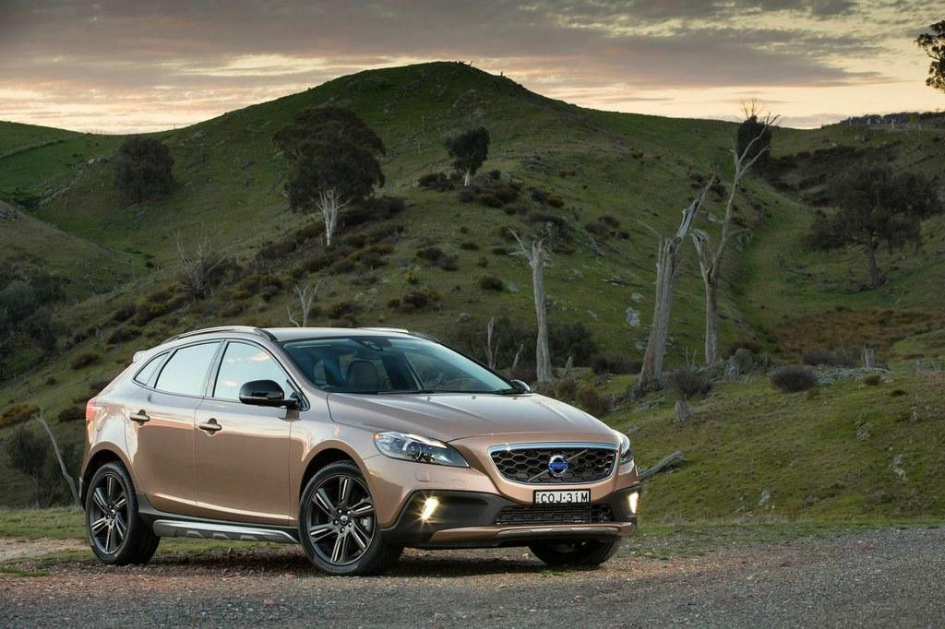
Thank You
Data Analytics Project
Cars
DATE

